Slide 1
Introduction
The following information has been developed by Safety in conjunction with the Pan-European Safety Working Group, in response to the current Coronavirus pandemic.
The information is intended to inform the development of local procedures to support Members return to on-site work, at the appropriate time, without risk to their health, or the health of others.
The information provides generic guidelines and consideration points and should be supplemented by thorough assessment of local working practices and local government guidance. Local government guidance should always take priority.
The guidance will continue to be reviewed and updated, and the updated guidance shared with key stakeholders.
Notes:
Slide start time 08:35

Slide 2
Contents
1. Information Sharing | 5. Workplace Management
2. Common Golden Health Rules | Common Area Management
Symptoms / Actions | Office Area Management
Social Distancing Behaviours | Communication Briefings
Hygiene Standards | Meetings / Meeting Rooms
3. Travel to and during work | Restaurant Areas
Car Share | Visitor Management
Company Bus | Management of 3rd Parties on site (Contractors / Visiting Drives)
Public Transport | Post / Package Deliveries
Pool Car | 6. Cleaning
4. PPE | Cleaning Common Areas
PPE Selection Logic | Cleaning Workstations and Work Equipment
Disposable Mask Use | Cleaning Areas Potentially Contaminated by a Member with Coronavirus
Disposable Gloves Use | 7. Member Daily Health Management and Actions
Management of Re-Useable PPE | 8. Common Case Management Protocol for Suspected / Confirmed Cases
 | 9. Management Audit & Review
Notes:
Slide start time 08:35

Slide 3







1. Information Sharing
When should information be shared?
What information should be shared?
Information regarding the rules must be shared with all Members, contractors and visitors.
The information should include, but not be limited to:
Provide Information at the first possible opportunity to anyone attending site, to give them chance to understand, and clarify any concerns
Coronavirus symptoms and how to react - Key point "if you have symptoms, stay at home"
Basic Hygiene Standards
Social Distancing Requirements
Common measures and specific site rules
Local work area rules and changes to working practices
Procedures for self-monitoring of health condition and reporting concerns
Importance of following the guidelines, and stop-call-wait in case the guidelines can't be applied, or if any other concern
The information should be shared :
Where possible, before people arrive at site for the first time,
Displayed so it is clearly visible on arrival,
Briefed by supervisors, Contractor Representatives, and visitor hosts, as soon as practicable once people have entered the site,
Refreshed on a periodic basis to maintain awareness
Any changes to the rules, should be quickly briefed to all Members.

Slide 4
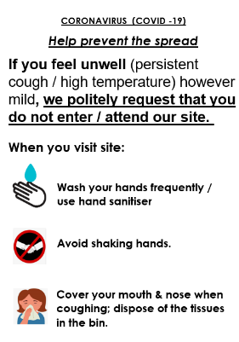
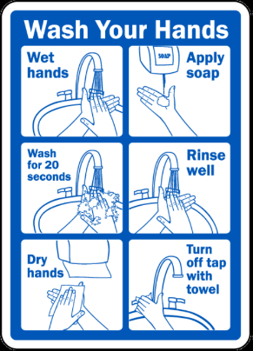

1. Information Sharing
How should information be shared?
Other methods of communication of information
Communication of information should respect the specific guidelines for "Meetings / Meeting Rooms" and "Communication Briefings
Posters at prominent locations - notice boards, rest areas, rest-rooms, etc…
Digital communication (where available/appropriate)
eg. email, SMS, communication apps, company website / intranet.
Supervisors to receive sufficient information to help them to share the information.
Format the information as guide cards or similar, to support standardised communication.
Location of Information
Basic information at access points to site
  (Key point - "if you have symptoms, do not enter site")
On all external and internal doors - basic, visual information - hygiene standards & social distancing
At relevant locations - local rules (eg. keep left in the corridor, rules for canteen use, rules for meeting rooms, etc...)
Where required, update and communicate the local procedures / work standards.
Brief any changes verbally – supports 2-way communicaton.

Slide 5

2. Common Golden Health Rules - Symptoms / Actions
Symptoms of Coronavirus
Action to take
STAY HOME
STAY INFORMED
STAY CONNECTED
High temperature >37.5^{O}C
Feel hot on your chest or back?
Stay at home
Follow government guidance and seek medical advice.
Follow government guidance for self-isolation*
Contact your supervisor to inform them of your situation.
*eg. UK guidance = Stay at home and don’t meet up anyone for 7 days. After 7 days, if you feel better, you can start your usual routine again
Continuous cough?
Coughing a lot for more than an hour, or 3 or more coughing episodes in 24hours?

Slide 6



2. Common Golden Health Rules - Social Distancing Behaviours
What is social distancing?
Social distancing guidelines
SOCIAL DISTANCING IS REDUCING CONTACT WITH PEOPLE TO REDUCE THE SPREAD OF THE INFECTION
Follow the social distancing guidelines specified by your government, at all times
(minimum = 1m, but varies by country)
Why is it important?
It interrupts human-to-human transmission
It can prevent spread of the virus
In can reduce the intensity of the epidemic
KEEP YOUR DISTANCE >1m
Physical greeting, such as a handshake or hug are not permitted.
Use a wave or a nod instead!
Limit in-person meetings and use phone calls and other tools when possible.
Avoid crowds

Slide 7

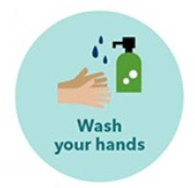
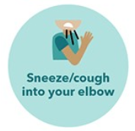

2. Common Golden Health Rules - Hygiene Standards
Basic Hygiene Standards
What are the guidelines?
MAINTAINING BASIC HYGIENE STANDARDS IS THE MOST EFFECTIVE WAY TO STOP THE SPREAD OF COVID-19
Keep your hands clean
Wash your hands frequently
Use soap and running water for at least 20 seconds
Dry hands thoroughly after washing
Use hand sanitiser (gel) if there is no soap and water
Make sure you wash your hands when:
  you arrive at work
  before you touch food
  you visit other places / return home
Why is it important?
When someone with COVID-19 coughs or exhales they release droplets of infected fluid. Most of these droplets fall on nearby surfaces and objects - desks, tables or telephones.
People can catch COVID-19 by touching contaminated surfaces or objects – and then touching their eyes, nose or mouth
WASH
COVER
DON’T TOUCH

Slide 8


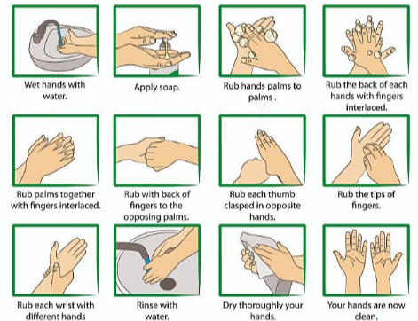




2. Common Golden Health Rules - Hygiene Standards - Visualisation
Good Hygiene Standards
Effective Handwashing
HOW TO WASH YOUR HANDS?
Wash hands frequently
with soap and water, or use hand sanitiser gel
Throw away
used tissues
(then wash hands)
Avoid touching your eyes, nose and mouth with unwashed hands
Catch coughs and
Sneezes with
disposable tissues
If you don’t have a tissue
use your sleeve
Avoid close contact with people who are unwell
TURN OFF THE TAP WITH A TOWEL

Slide 9





3. Travel to and during work - Car Share
Guidelines for travelling to work by car share
PRIORITISE INDIVIDUAL TRAVEL
AVOID CAR SHARE IF POSSIBLE
CAR SHARE – MAX 2/CAR
(Driver + 1 passenger in rear)
Members should not travel if they have symptoms of coronavirus.
It is strongly recommended that face masks are worn by both the passenger and the driver
Follow basic hygiene practices
Wash hands before and after journey
The passenger should sit on the opposite side of the car to the driver, to maximise distance.

Slide 10
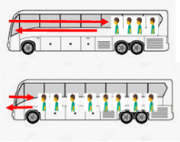
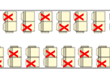

3. Travel to and during work - Company Bus
Guidelines for travelling using company bus
Boarding the bus / Seating arrangements
PRIORITISE INDIVIDUAL TRAVEL
AVOID TRAVELLING BY BUS IF POSSIBLE
BUS FILLS UP FROM THE BACK FORWARDS
BUS EMPTIES FROM THE FRONT FIRST
Members should not travel if they have symptoms of coronavirus.
ONE MEMBER/2 SEATS
SITS ALONE, DIAGONALLY TO THE MEMBER BEHIND
All Members should wear a face mask
Follow basic hygiene practices
Wash hands before and after journey
The bus will be cleaned before / after each use
Follow any additional specific guidelines that have been agreed with the bus company
If the above guidelines cannot be met then additional buses must be used, or alternative transport

Slide 11





3. Travel to and during work - Public Transport
Guidelines for travelling by public transport
PRIORITISE INDIVIDUAL TRAVEL
AVOID PUBLIC TRANSPORT IF POSSIBLE
Follow any specific guidelines that have been produced by the transport company
Members should not travel if they have symptoms of
coronavirus
FOLLOW SOCIAL DISTANCING GUIDELINES & BASIC HYGIENE STANDARDS
All Members should wear a face mask
Do not sit next to anyone on the bus
Follow basic hygiene practices
Wash hands before and after journey
PAY IN ADVANCE IF POSSIBLE
USE CASHLESS PAYMENT OR TAKE CORRECT CHANGE

Slide 12


3. Travel to and during work - Pool Car
Guidelines travel by pool car during work
BEFORE TRAVEL AT ANY TIME, CONSIDER:
CLEAN ALL TOUCH POINTS
BEFORE & AFTER USING POOL CAR
Is the trip business critical?
Is there an alternative – Skype meeting?
How many members really need to go?
  Steering wheel
  Controls
  Gear stick
  Touch screen
  Door handles (internal / external)
  Keys, etc
Individual travel should be prioritised if possible
Multiple Members = multiple vehicles
If this is not possible, apply the "car share" rules.
Members should not travel if they have symptoms of coronavirus.
All Members should wear a face mask
Supply appropriate cleaning products for Members to use (eg. disinfectant / alcohol wipes)
Follow basic hygiene practices
Wash hands before and after journey

Slide 13



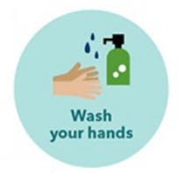




4. PPE - PPE Selection Logic
Guidelines where social distancing is possible
CONFIRM SOCIAL DISTANCING GUIDELINES OF YOUR COUNTRY
2. GUIDELINES FOR MEMBERS IN CONTACT WITH PUBLIC/EXTERNAL VISITORS/DELIVERIES
(eg. Security, Reception, stores receiving, etc…)
1. GUIDELINES FOR STANDARD WORK
(eg. office/production/workshop, etc…)
Apply Basic Hygiene & social distancing rules
No additional specific PPE requirements
In case of social demand / Member individual request, the following can be provided:
  Mask - Type I Surgical (EN14683)
  Standard Safety Glasses
Increase frequency of hand washing
Social distancing rules apply
Provide Members with the following:
  Mask - Type II Surgical (EN14683)
  Standard Safety Glasses and/or Perspex screen
  Disposable gloves
or
Always confirm compatibility with existing PPE

Slide 14





4. PPE - PPE Selection Logic
Guidelines where social distancing is not possible
CONFIRM SOCIAL DISTANCING GUIDELINES OF YOUR COUNTRY
2. GUIDELINES FOR MEMBERS IN CONTACT WITH PUBLIC/EXTERNAL VISITORS/DELIVERIES
(eg. Security, Reception, stores receiving, etc…)
As per std Work + Type II Surgical Mask + disposable gloves
1. GUIDELINES FOR STANDARD WORK
(eg. Office/production/workshop, etc…)
3. GUIDELINES FOR AT RISK MEMBERS
(eg. Company Doctor, medical staff, etc…)
Increase frequency of hand washing
Type II Surgical Mask (EN14683) / FFP2 (PPE)
Safety glasses or goggles
Disposable coveralls
Medical gloves
Provide Members with the following:
  Mask – Type I (Standard)
  Safety glasses or visor
or
Always confirm compatibility with existing PPE
For Members already wearing gloves as standard PPE, increase the frequency of replacement
* Authority request FPP2 or above for medical staff having to perform high risk procedure like intubation - only FFP2 mask is considered to be PPE.

Slide 15



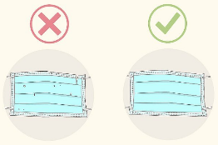

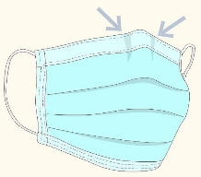

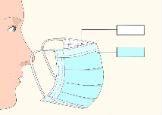
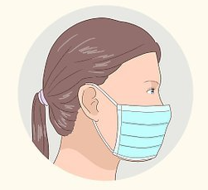
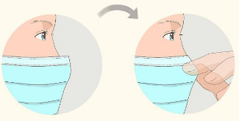
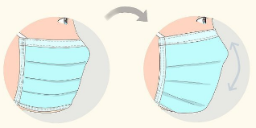
4. PPE - Disposable Mask Use
Disposable face-mask instructions
Face-mask fitting instructions
The following generic steps can be followed…
Follow the instructions supplied with the mask
Wash your hands before touching the mask
Wash your hands before and after fitting, adjusting, or disposing of the mask
Check the mask for defects
Check the condition of your mask before use
Do not use mask which is damaged or dirty
Orientate the top of mask correctly
Dispose of masks in the designated place
This may be separate from other waste
Ensure the proper side of the mask faces outwards.
The inside of most medical masks are white in colour, while the outside has a colour of some sort.
Place the mask on your face
Pick up by the loops and put 1 loop around each ear
Avoid touching the mask while using it
If you do, wash your hands
Adjust the nose piece.
Use your index finger and thumb to pinch the top edge of the mask around the bridge of your nose
Follow the local procedure for mask replacement
Normal frequency of mask replacement 4 hourly
This may vary depending on task / conditions
Fit the mask to your face and under your chin.
Adjust it to ensure it covers your face and mouth, and so the bottom edge is under your chin.

Slide 16

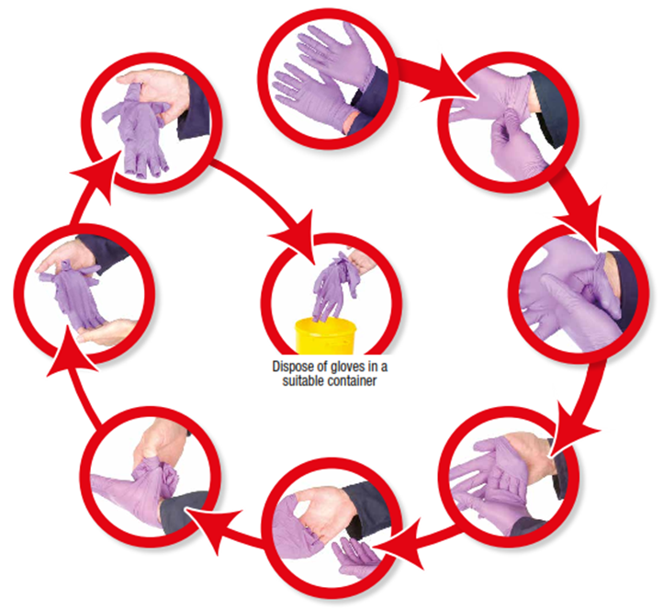
4. PPE - Disposable Gloves Use
Instructions for use
Instructions safe removal
BEFORE USE
Follow these steps to protect skin from contamination
Wash your hands before fitting, and after disposing of the gloves
Check the condition of your gloves before use
Do not use gloves which are damaged or dirty
AFTER USE
Dispose of gloves in the designated location. This may be separate from other waste.

Slide 17
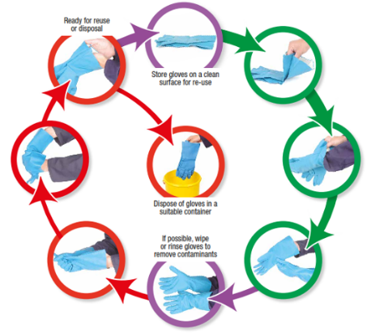

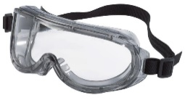

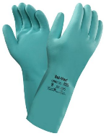

4. PPE - Management of Re-Useable PPE
Guidelines for storage and cleaning
Instructions for safe putting-on and removal
Multiple-use PPE (safety glasses / visors / gloves)
Follow these steps to protect skin from contamination
Should be cleaned before and after each use
Should be stored according to the manufacturers’ guidance
Should NOT be shared between users
Supply appropriate cleaning products (eg. alcohol or disinfectant wipes)
Carry out cleaning and drying in a clean area to avoid contamination of the RPE

Slide 18




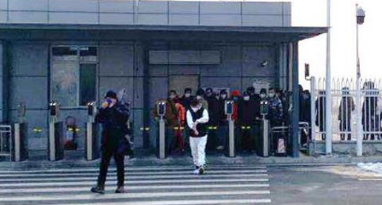
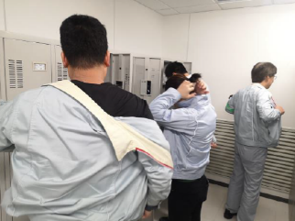

5. Workplace Management - Common Area Management
Assessment of Common Areas
Possible Control Measures
Possible control measures could include
Assess the possibility of social distancing in common areas.
Closing common areas to reduce pedestrian traffic
CONSIDERATION POINTS
Staggered start / finish / break times to reduce traffic in common areas
Likely volume of pedestrian traffic
Direction of travel
Alter layouts to create more space for movement
Pinch points (eg. doorways / corridors / site access points)
Floor markings to define routes and indicate social distancing requirements
Gathering points (eg. reception areas, vend areas, locker / changing rooms / group areas / rest areas, elevators, etc…
Chocking doors open at busy times to speed up the flow of pedestrian traffic
One way systems maybe required where 2-way prevents social distancing
Only one Member allowed in elevator at once

Slide 19




5. Workplace Management - Office Area Management
Management of Office Attendance
Office Layout
Implement procedures so that social distancing and hygiene best practices can be followed
Where possible move desk / work station to achieve social distancing guidelines
Do not allow Members to sit at adjacent desks
Organise desks to avoid face-to-face work
Reduce the number of Members in the office at any one time, by utilising home working where possible
This may be done on a rota basis to ensure each Member has equal work / home ratio.
Sample Rota | Mon | Tues | Weds | Thurs | Fri
Member 1 |  |  | ☞ | ☞ | 
Member 2 |  |  | ☞ | ☞ | 
Member 3 | ☞ | ☞ |  |  | ☞
Member 4 | ☞ | ☞ |  |  | ☞
Consider safe pedestrian traffic flow within the office
  Clean desks and equipment at the start and end of shift (common touch points)
  Make alcohol wipes available for Members to use
  Ensure facilities are available for Members to follow hygiene best-practices (eg. hand gel)
Image ≤ 50% Members in office where possible

Slide 20


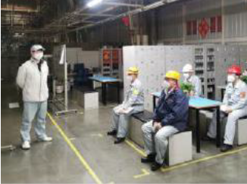

5. Workplace Management - Communication Briefings
Guidelines for communication briefings
NO LARGE GROUP BRIEFINGS
(maximum 5 Members)
Plan Communication so that social distancing can be respected
Communication should be cascaded through the management chain to teams
BRIEFINGS DURATION
Reduce to minimum time necessary
Where possible, alternative forms of communication should be used (eg. whiteboard / poster / communication app)"

Slide 21


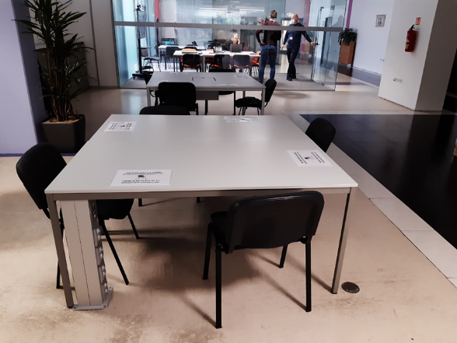



5. Workplace Management - Meetings / Meeting Rooms
Organisation of Internal Meetings
Meeting Room Layout
MEETING PLANNING
MEETING ROOM
Consider, is the meeting business critical?
Use an alternative method where possible
Reduce to the minimum number of attendees
Choose a large enough space (ideally ventilated) to allow for social distancing to be applied
Re-layout meeting rooms to ensure social distancing / reduce seat numbers if required
Reduce meeting time to the minimum (<30 minutes)
Keep doors open during and between meetings
Clean desks / equipment before and after meeting with disinfectant wipes
All attendees to wash hands / gel after the meeting
Face masks must be worn
MEETING MANAGEMENT
Ensure social distancing guidelines are applied among participants

Slide 22
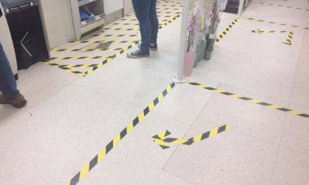

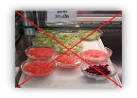
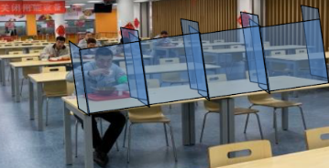


5. Workplace Management – Restaurant Areas
Measures to reduce the volume of Members in the restaurant / canteen at any one time
Measures to ensure social distancing
Stagger lunch breaks if required to reduce numbers of Members attending at one time
Encourage Members to bring own lunchbox
Re-design layouts and pedestrian traffic flow
Floor markings to indicate flow, distances and recommended flow.
Measures to prevent contamination
No self service food counters, such as salad bars. Only serve pre-prepared / pre-packed food.
Perspex screens at payment points
Change seating arrangements / reduced seating
Perspex screens at tables, in case that social distancing requirements cannot be met
Minimise handling of cash – contactless payments only
Wear masks (except when eating/drinking)
Wash hands before and after eating
Increase frequency of cleaning of tables and chairs
Eliminate face-to-face seating

Slide 23







5. Workplace Management - Visitor Management
Guidelines to ensure the health & safety of visitors
Social Distancing & Hygiene Measures
ESSENTIAL VISITORS ONLY!
APPLY SOCIAL DISTANCING GUIDELINES & HYGIENE STANDARDS
The definition of "essential visitor" should be clarified for the particular site and keep the number of visitors to an absolute minimum
Apply social distancing in visitor receptions, including interaction with reception staff, Members, and other visitors
Where possible hold meetings by video conference
No physical greeting
Keep visit duration to a minimum
Use floor markings or barriers to maintain social distancing at reception desk
Limit site access only to areas essential to the purpose of the visit
Minimise / remove need for documentation handling
Make visitors aware of the site rules regarding Coronavirus prevention, eg. signs at entrance / near reception desk
Reception staff complete visitor log book. No need for visitor to touch.
Provide hand sanitiser gels for visitors
Follow the guidelines for meetings / meeting rooms
Wash your hands after the meeting

Slide 24

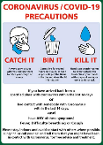



5. Workplace Management – Management of 3rd Parties on Site
Guidelines for contractor management
Guidelines for visiting drivers
CONTRACTOR WORK ON-SITE ONLY IF BUSINESS CRITICAL
Implement social distancing measures at driver receptions / gatehouses
The definition of "business critical" should be clarified for the particular site
Make drivers aware of the site rules, before entering site (where possible before arriving at site)
Share the site guidelines with the contractors in advance of them attending site
Rules may need to be produced in multiple languages
Contractors’ own guidelines should be reviewed to ensure alignment with internal procedures.
Risk assessments and method statements must include control measures for coronavirus / social distancing
Face masks are available to issue to drivers
Ask drivers asked to confirm they have no symptoms of coronavirus. Procedures in place to manage drivers who think they may have symptoms
Contractors to follow internal Guidelines at all times whilst on site (reconfirm through regular site audit)
Ensure adequate facilities for drivers to wash their hands

Slide 25


5. Workplace Management - Post / Package Deliveries
Guidelines for receiving post / packages
Organise postal receiving area so that social distancing can be maintained with delivery person / postman
Increase frequency of cleaning of tables and chairs
No hand to hand acceptance of packages – eg. leave packages on table or in a receiving area.
Where possible, remove plastic packaging before parcels / packages are forwarded internally.
Where possible parcels should NOT be handled immediately (guideline 3 hours)
Wash hands after handling packages and touching surfaces where packages have been placed.
If parcels must be handled, then appropriate disposable gloves should be used

Slide 26


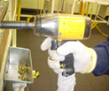






6. Cleaning - Common Areas, Workstations and Work Equipment
Cleaning of Common Areas
Cleaning of Workstations and Work Equipment
Increase frequency of cleaning and disinfecting of objects and surfaces that are touched regularly
Clean regularly the work equipment that is used by multiple Members
Apply normal cleaning procedures, using normal cleaning and disinfectant products
A specific assessment must be made in each work area
eg. workstations, tools, printer touchscreens, machine start/stop controls, office equipment, etc…
Eg - door handles, hand rails, toilets, vending machines, card machines, kitchenettes, turnstiles, etc…
Guideline for frequency = 2-3 times per day
[at a minimum - start and end of shift, and before another Member uses the work station / equipment]
Guideline for frequency = minimum 2-3 times per day
[determine based upon frequency of use]
Using normal disinfectant and cleaning products
Make alcohol wipes available for Members to clean buttons / screen down before use
Make alcohol wipes available for Members to clean equipment with

Slide 27



6. Cleaning - Areas Potentially Contaminated by a Member with Coronavirus
Cleaning in potentially contaminated areas
IDENTIFY, CLEAN & DISINFECT ALL POTENTIALLY CONTAMINATED AREAS
A specific risk assessment will be required to develop the cleaning procedures.
Before Cleaning (eg. area isolation / ventilation),
identify the areas where the Member is likely to have
contacted surfaces
Cleaning company to develop the procedures with reference to government guidance
Additional PPE may be required for cleaning potentially contaminated areas
Where possible isolate and ventilate the areas before cleaning
(guideline = 1 hour)
Eg. disposable gloves, apron, and PPE to protect the cleaner’s eyes, mouth and nose.
Public areas where a the Member has passed through and spent minimal time, such as corridors, which are not visibly contaminated with body fluids can be cleaned thoroughly as normal
Clean and disinfect all surfaces that the person has come into contact with, including objects which are not visibly contaminated with body fluids, and all potentially contaminated high-contact areas such as bathrooms, door handles, telephones, and work equipment
Apply correct hygiene practices for the putting on, removal and disposal of PPE
Confirm the waste removal procedure with the waste management contractor, following government guidance
This may be treated in line with existing medical waste, or a new waste stream may be required

Slide 28


7. Member Daily Health Management and Actions
Member daily health self-check
Member health access rules
Member must carry out a daily confirmation of own health condition
In cases where a Member has confirmed Coronavirus, Coronavirus symptoms, or a Member of their household has Coronavirus, follow the guidelines "Recognising the symptoms & how to react“
Some Members may have been identified as being in a "high risk group" due to a specific health condition or being over a certain age
  For these Members any additional government guidance must be followed, or the guidance of the Member's health practitioner.
  eg. this may be a requirement to self-isolate for a longer period of time."
Including self-assessment against the main Coronavirus symptoms, including temperature check
Make thermometers available at access points to site
for Members who do not have a thermometer at home,
Each Member should record that they have carried out a daily self check
☑☒
If symptoms are detected then follow the guidelines "Recognising the symptoms & how to react"

Slide 29
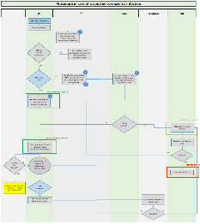
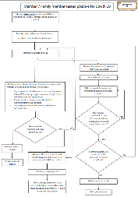
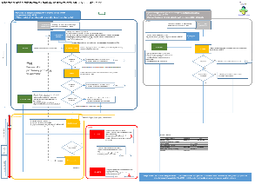
8. Common Case Management Protocol for Suspected / Confirmed Cases
Case management protocol (suspected case / confirmed case)
A case management protocol must be established for each site to identify the actions required in the event of a suspected or confirmed case on site.
The protocol will vary depending on the nature of the business, but should include as a minimum:
Instructions to Members to raise a concerns
The process for how to raise a concern
How to manage the Member immediately after they have raised a concern
How to move the Member off-site / home safely
Area isolation / cleaning requirements
Communication and escalation
Identification of those who may have had prolonged / close contact with the Member
Ongoing communication with the Member once they have left site
WHAT A PROTOCOL SHOULD INCLUDE?
The protocol must be shared with Supervisors and those with specific responsibilities

Slide 30


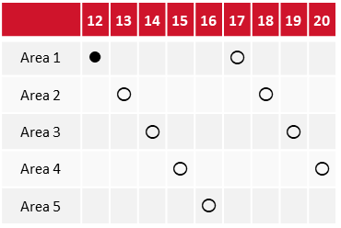
9. Management Audit & Review
Guidelines for Audit
Management Review
CONFIRM INTERNAL PROCEDURES
IDENTIFY CONCERNS
Each site should confirm that their internal procedures contain, as a minimum, reference to each of the guidelines within this document.
Any concerns identified on the audit should be immediately rectified, where possible.
IMPLEMENT AUDIT PROCESS
Audit results should be summarised and reviewed with management.
Each site should implement an audit process to confirm that local procedures are being followed.
DEVELOP COUNTERMEASURES
ESTABLISH THE AUDIT SCHEDULE
Countermeasures should be developed, implemented and procedures updated and communicated as required.
Establish an audit schedule covering all relevant areas of site and all Members, including contractors and visitors.
Any suggestions for improvement to procedures should be shared with Safety for Pan-E best practice sharing.

